Slide 1


V. T. Patel Department of
Electronics and Communication Engineering
EC249 MINI PROJECT-II
Object Detector Using Arduino
With GUI & App
MADE BY:
Amartya Singh(17EC088)
17ec088@charusat.edu.in
UNDER GUIDANCE OF:
VISHAL TANK
vishaltank.ec@charusat.edu.in

Slide 2
Lets have a look at Programming part of project

Slide 3
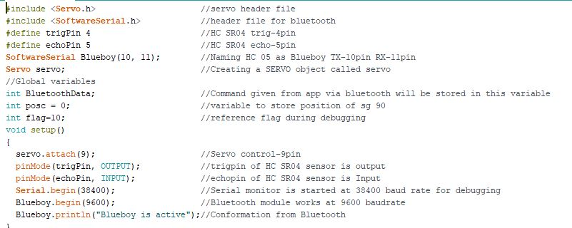
Including headers, defining pins & global variables & void setup()

Slide 4
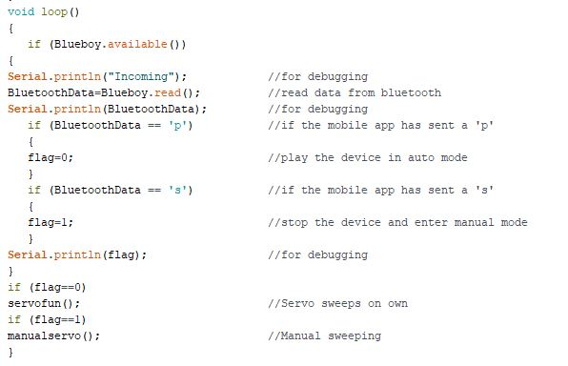
void loop() will control based on instructions received from APP via Bluetooth

Slide 5
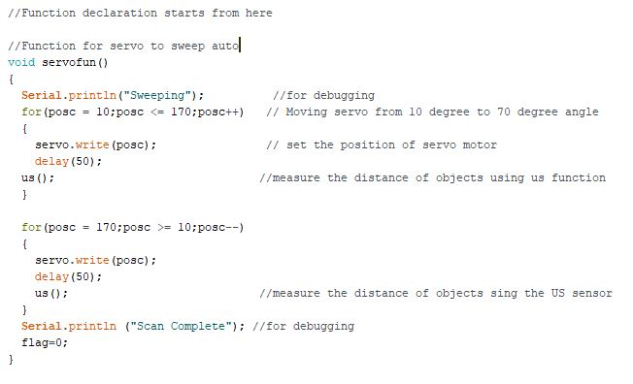
Function to sweep servo in automatic mode

Slide 6
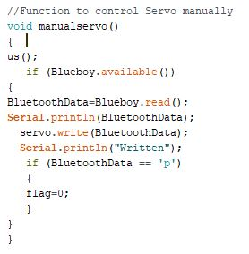
Function to sweep servo in manual mode

Slide 7
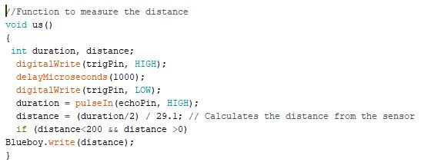
Function to calculate distance of object

Slide 8
Android application is developed using a software named as processing So codes were auto generated by that software only.

Slide 9
References
HC-SR04 data sheet: https://components101.com/ultrasonic-sensor-working-pinout-datasheet
HC 05 data sheet: https://components101.com/wireless/hc-06-bluetooth-module-pinout-datasheet
SG 90 data sheet: https://components101.com/servo-motor-basics-pinout-datasheet
Processing: https://processing.org/

